Slide 1
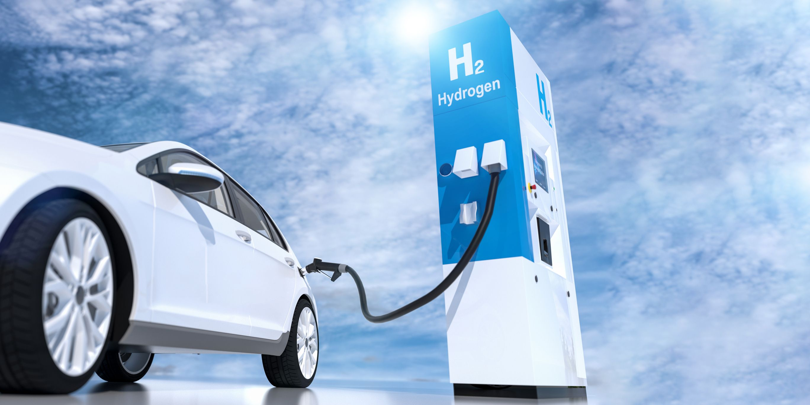
Hydrogen Fuel Cell Vehicles
ARUN AGARWAL

Slide 2


Introduction:
Gasoline-powered automobile- dominates as primary transportation fuel type (90%+)
Fossil fuels-primary energy source
When combusted, release hazardous compounds into air -> hurts all life and causes huge imbalances on planet
Nonrenewable and will not last forever
WE must hasten environmentally sustainability initiatives
Currently, EVs only represent 2.5% of 1.4bil vehicles
New fuels for transportation like hydrogen fuel-cells provide a beneficial alternative

Slide 3
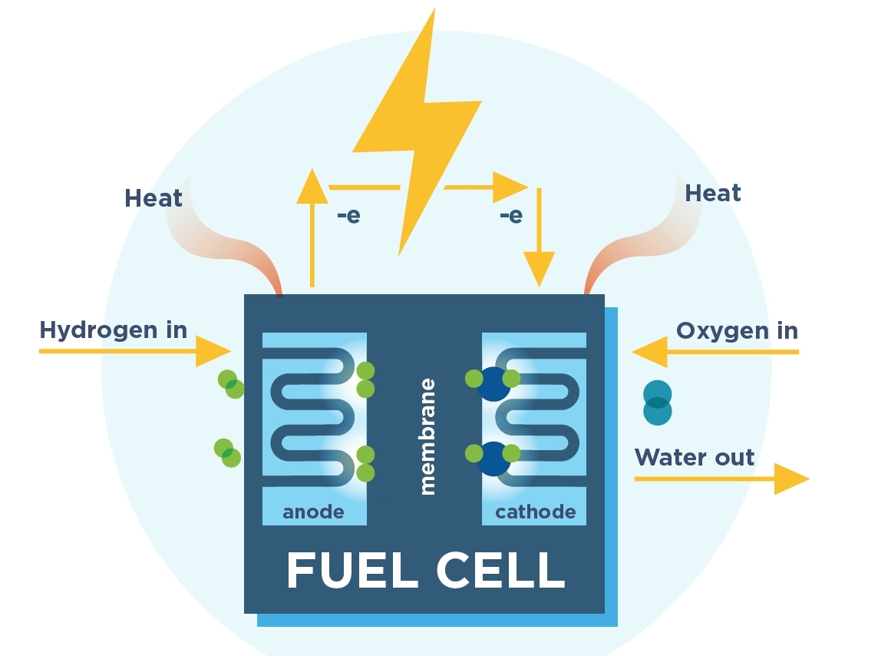
What are Fuel Cells?
Hydrogen fuel-cell: a device that converts chemical energy stored by hydrogen fuel into electricity
Gas Battery
Silent, release no pollutants, can be used in enclosed areas, are modular (can be stacked), do not degrade over time, and do not leak energy
Most common type: PEM fuel cell
Electrolyte membrane is sandwiched between a positive electrode (cathode) and a negative electrode (anode)
Used in: cars, small devices (batteries in laptops and phones), space technology, houses, factories, etc.
“Fuel cells have been used in NASA space-craft since the Gemini Program in the 1960’s and even today provide electricity and drinking water for astronauts on Space Shuttle flights” (Sepuplhs 1)
Small fuel cells: laptops, cell phones, and military applications
Large fuel cells: provide electricity for emergency power in buildings and in remote areas that do not have power lines.
http://static1.squarespace.com/static/53ab1feee4b0bef0179a1563/5d42fcd4f92a2d00013ab0ec/5d4303c2e7786a00011c2a86/1565898642204/fuel%2Bcell%2Bdiagram.jpg?format=1500w

Slide 4
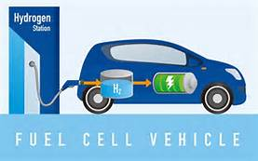
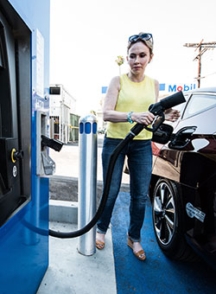
Hydrogen Fuel Cell Vehicles:
As the name suggests, vehicles that use hydrogen to produce electricity via a fuel cell
Reasons of Interest:
Hydrogen's ability to power fuel cells in zero-emission electric vehicles
HFCV potential for domestic production
HFCV potential for high efficiency (better range and sustainability)
Most are automobiles and transit buses that have an electric motor powered by a fuel cell
A few of these burn hydrogen directly
Waste products: heat and water- THAT’S IT!
45% efficiency, 10% higher than combustion engines
The U.S. Department of Energy leads research efforts to make hydrogen-powered vehicles an affordable, environmentally friendly, and safe transportation option

Slide 5
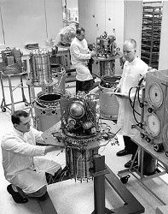
History
Fuel cell idea first examined in 1839 by Sir William Grove in England
1932- First successful fuel cell (took almost a century to finally create one)
Technology rapidly developed to meet needs of space industry
NASA was and still is the largest user of hydrogen as a fuel. NASA began using liquid hydrogen in the 1950s as a rocket fuel and was one of the first to use fuel cells to power the electrical systems on space craft
Fuel cells were modified to work in a range of things (electronics, cars, hospitals, factories)
Hydrogen was considered an alternative fuel under the Energy Policy Act of 1992 (which allows it to qualify for alternative fuel vehicle tax credits)
Hydrogen fuel cells were used extensively by NASA in the 1960s for the Apollo and Gemini Space Missions
https://i.pinimg.com/originals/d5/fb/f9/d5fbf987ab5341ae39002958f98cec3d.jpg

Slide 6
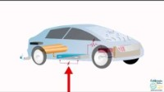
How Does it Work:
https://www.youtube.com/watch?v=EgFCLBDn2es&t=67s

Slide 7
How it Works:
Have two electrodes (anode and cathode) in contact with a material that can conduct ions, called an electrolyte
Hydrogen is taken from another fuel source and put on anode side; oxygen is taken from the air and put on cathode side
Hydrogen molecules break apart into protons and electrons and protons move across membrane to cathode
Electrons are forced to travel through an external circuit to perform work, creating electricity
Once electricity is produced from the fuel cells, as described in the video, it will essentially function like a normal electric vehicle
When driver steps on accelerator, hydrogen and oxygen are sent to fuel cell
Produces electricity (in video) that powers the motor and has water as byproduct
Electrons recombine with proteins on cathode side, and with oxygen, water is formed as byproduct
Chemical Reaction: 2H2 + O2 → 2H2O
Energy is converted from chemical to electrical to mechanical
Four main parts in vehicle: fuel cell stack, hydrogen storage tank, electric motor and power control unit, and battery

Slide 8
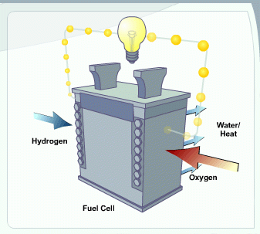
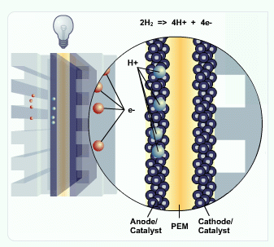
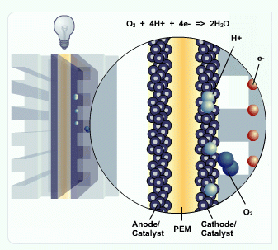
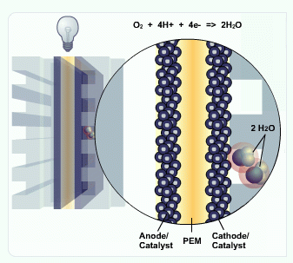
https://www.energy.gov/eere/fuelcells/fuel-cell-animation-text-version

Slide 9
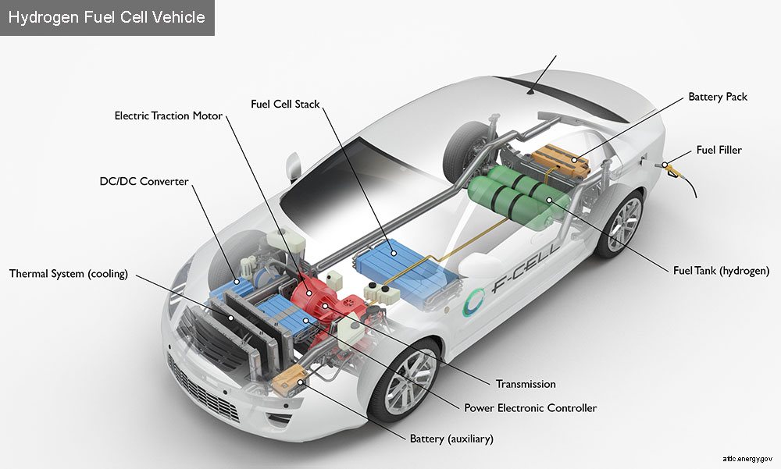
Essential Parts of the HFCV:
Hydrogen Storage Tank:
Hydrogen gas must be “compressed at extremely high pressure at 5,000 to 10,000 pounds per square inch (psi) to store enough fuel to obtain adequate driving range” (Hydrogen Fuel Cell Vehicles 2)
Tank takes up most space
Electric Motor and Power Control Unit:
Governs flow of electricity
Draws power from battery or fuel cell stack and delivers it to the motor to propel the car
Battery:
Stores electricity generated from regenerative braking
https://afdc.energy.gov/vehicles/how-do-fuel-cell-electric-cars-work

Slide 10
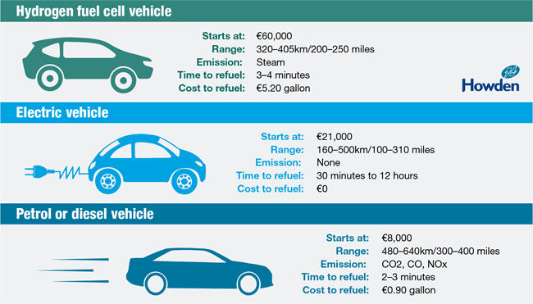
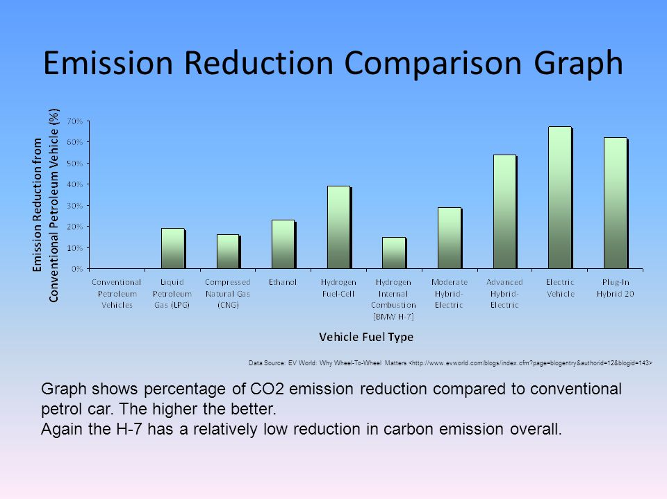
Why do we need them?
Has an amazing potential to impact our technology future
Will cut projected U.S oil use in half over the next twenty years, if used
In general, using this tech can hold off effects of climate change
“A fuel cell vehicle would produce 200 grams of carbon dioxide-equivalent per mi…compared to 235g…for a HEV” (Hydrogen Fuel Cell Vehicles 1)
https://www.howden.com/getmedia/f65a47f3-3332-48ea-aedc-fc07f936903d/HydrogenFuelCell_WebGraphic.png?width=650&height=371
https://www.google.com/url?sa=i&url=https%3A%2F%2Fslideplayer.com%2Fslide%2F10296242%2F&psig=AOvVaw29MW4PTM8wtDC8wTm3n_Q4&ust=1622579881887000&source=images&cd=vfe&ved=0CA0QjhxqFwoTCMjMxoXk9PACFQAAAAAdAAAAABAd

Slide 11
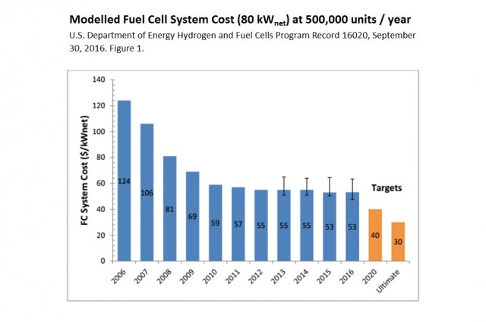
Advantages:
Quick refueling (compared to batteries)
Zero emissions, if hydrogen is produced the right way
Since pure H2 doesn’t exist plentifully, it must be made from other energy sources like water, natural gas (most common), or coal.
If made from fossil fuels, will be dangerous byproducts (ex. CO2)
High fuel efficiency (performance does degrade through use)
Releases most energy as electrical current rather than heat
Few moving parts so little loss of energy due to friction
Quiet and Domestic Fuel Source
Electrodes in fuel cells are stable since they act as catalysts and are not chemically changed in the process
Environmentally sustainable
Byproduct of heat can be used where heat supply needed (can be used as heat for the car itself, for example)
No pollutant or toxin release—can be used in enclosed areas w/o affecting human health
Hydrogen does not leak and has longer shelf-life than batteries
Prices are drastically decreasing → $39,000 by 2023 and $21,600 by 2035
Usability is increasing with more hydrogen fuel stations being built daily
https://images.hgmsites.net/med/fuel-cell-system-cost-modeled-at-500000-units-a-year-chart-matthew-klippenstein_100604579_m.jpg

Slide 12
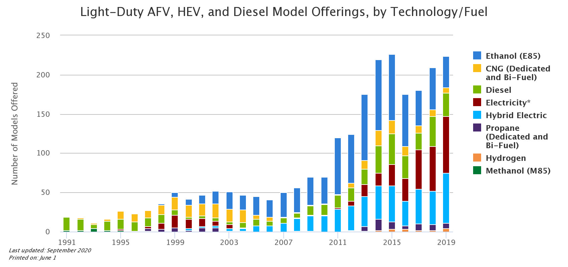
https://afdc.energy.gov/data/10303

Slide 13
Disadvantages:
The Refueling Challenge: Production of HFCVs is limited because people won't buy them if refueling stations are not easily accessible, and companies won't build refueling stations if they don't have customers with HFCVs
Hard to store hydrogen, a gas, on board a vehicle
Since hydrogen is a gas and is much less dense than air, it will tend to disperse very rapidly upward into the air—fuel stations must be constructed diligently
Similar to EVS, not much range:
“…can travel no more than about 350 km (220 mi) on a single tank of fuel, whereas 500 km (310 mi) is the typical minimum distance for commercial vehicles” (Raven 207)
Hydrogen being a gas causes an inadequate proportion to be stored, reducing range
However, this is rapidly improving (technology improving and more fuel stations)
Currently, to obtain the hydrogen, another energy source must be utilized, and the extraction of which may be harmful
Hydrogen is very combustible and spreads quickly—potential threat
Not likely because of the well-designed containers for the hydrogen

Slide 14
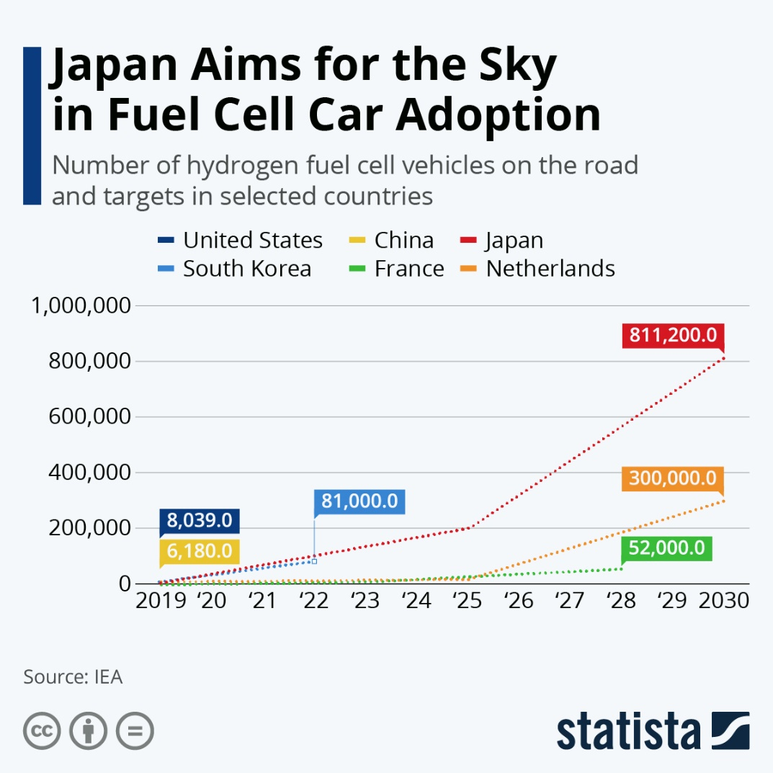
Distribution & Popularity (Worldwide):
Twenty to thirty fuel cell buses were sold to transit systems in Europe in 2002
In 2004, mass-production of 100,000 fuel cell cars was planned to be put onto the market
Iceland created the world's first hydrogen economy
In February of 1999 they made a $1 million joint venture called the Icelandic New Energy
Promotes increased use of renewable resources to produce hydrogen
Plans to build first fleet of fuel cell buses
Canada and Germany have shown uses of hydrogen as energy
“The future of hydrogen as a fuel is so conceivable that by the year 2050 the world may be considered to be in the Hydrogen Age” (Dunn, 97).
Generally, MDCs have more access to HFCVs causing unequal distribution

Slide 15
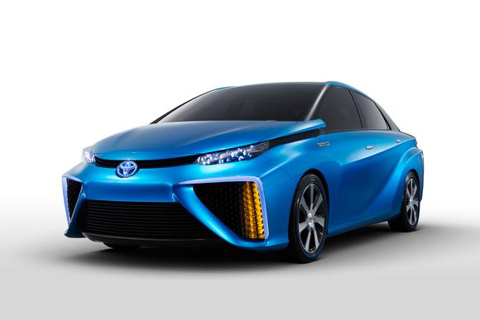
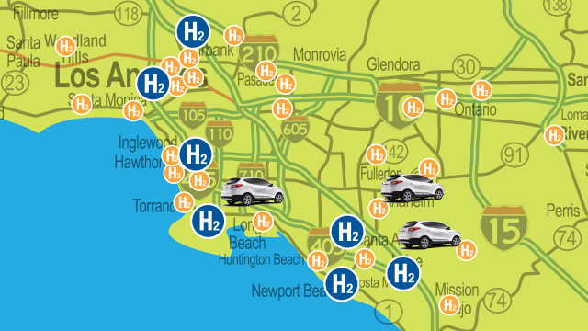
Distribution & Popularity (United States):
Several vehicle manufacturers have begun making light-duty hydrogen fuel cell electric vehicles available in select markets like southern and northern California, where there is access to hydrogen fueling stations
2008- Honda produced first commercial HFCV
End of 2008- 61 hydrogen fueling stations, 1/3rd in California
2012- used mainly in industrial and governmental fleets
Toyota and BMW made a fuel-cell technology vehicle in November 2013 (top right)
Hyundai leased 1,000 hydrogen cars in U.S. starting in 2015
2015- Honda launched new generation of FCEVs- Clarity
Renault and Nissan partnered with Daimler and Ford to share cost of making one to be in market in 2017
“Estimates from the U.S Department of Energy predict a future mid-size car in the 2035-2045 time frame, powered by fuel cells and using hydrogen generated from natural gas, is projected to have lifecycle GHG emissions slightly lower than that for a hybrid electric vehicle” (Hydrogen Fuel Cell Vehicles 1)
A NAS study “projected that FCVs could account for approximately 2 million vehicles, out of the total of 280 million light duty vehicles, in 2020, and grow rapidly from then on, increasing to 25 million vehicles in 2030” (Hydrogen Fuel Cell Vehicles 1)
The majority of popularity lies in the other uses of hydrogen fuel cells, as discussed previously
2035 HFCV will cost $21,600, still more than gas powered cars

Slide 16
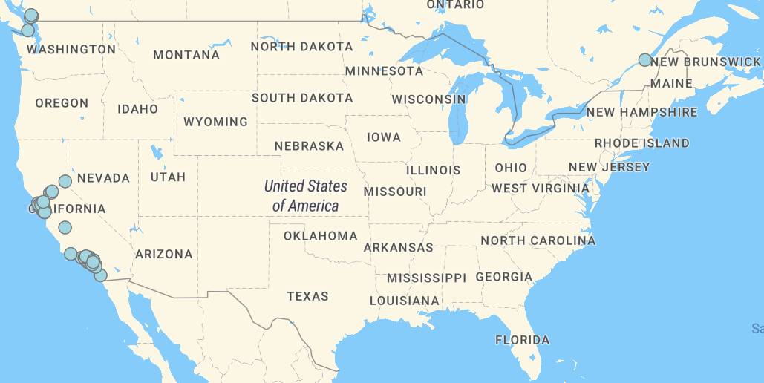
https://afdc.energy.gov/vehicles/fuel_cell.html

Slide 17
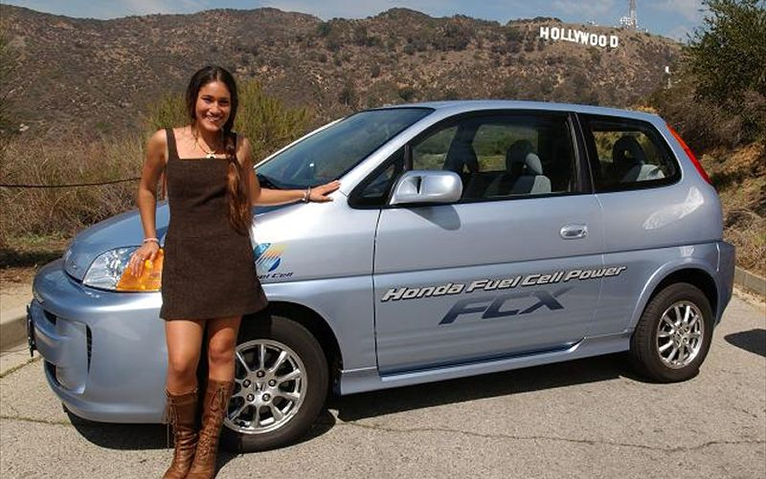
Can we make it more widely distributed? If so, how?
Answer: YES
H2 must become more readily available so that it will be more popular
Must create a national hydrogen infrastructure resembling the current infrastructure for gasoline (ex. Make more hydrogen fueling stations and make them more spread out—not just in California
The cost for a fuel cell system must be decreased more than two times to make it comparable to combustion engines and to make it more popular/distributed
In general, need to let world know how much their gas-powered cars are destroying the earth and how much hydrogen cars can prevent the catastrophe
Make pipelines or make hydrogen locally
Make people familiar with technology so they will desire it
Will need government support- $55 billion
Will need tax/subsidy policies for high initial cost
Actress Q’orianka Kilcher has become the first person ever whose first car runs on hydrogen. She took possession of the FCX on March 7, 2007, in Universal City, California.

Slide 18
New Technology:
2012- new metal to be used for the anode and cathode: Pt3Ni(III)—platinum-nickel alloy that replaces traditional platinum used
2013- new breakthrough- new chemical that can power them entirely
Recent Breakthrough: Hydrogen in solid pill form so vehicles can carry enough H2 for long-distance travel- “hydrogen on demand” system
Unfortunately, too expensive to be usable in everyday use
Current Research:
Cost-effective and zero-emission way to use solar energy to convert water into electricity (to power the fuel cells)
Method to separate hydrogen from methane in a steam reforming chemical process
Ways to use methanol and ethanol (alcohols) in fuel cells
Creating fuel cells that depend on methanol/oxygen or ethanol/oxygen reactions

Slide 19
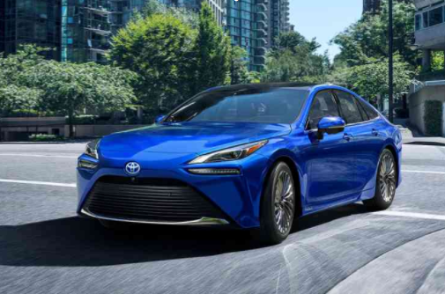
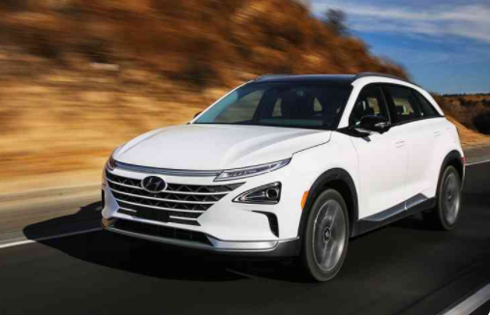
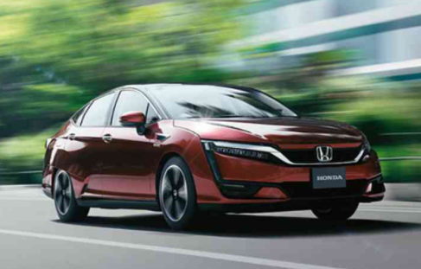
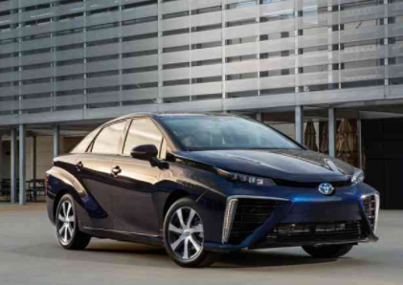
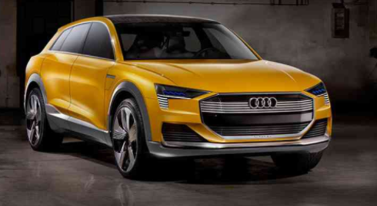
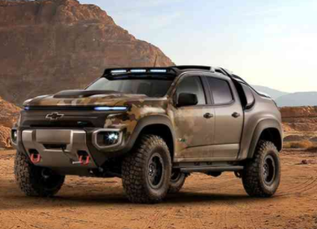
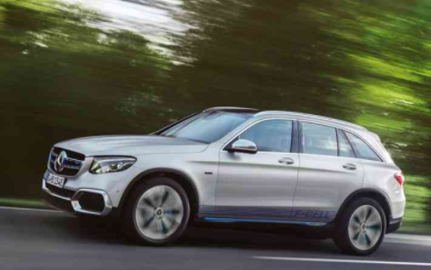
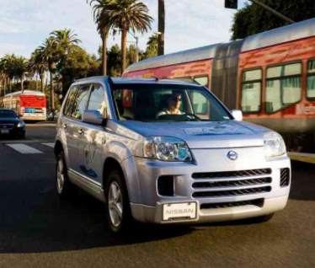
Currently in the Market:
Toyota Mirai 2021
Hyundai NEXO
Honda Clarity Fuel Cell
Toyota Mirai (FCV)
Audi H-Tron Quattro
Chevrolet Colorado ZH2
Mercedes-Benz GLC F-Cell
Nissan X-Trail

Slide 20

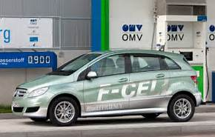
Conclusion:
HFCV are an environmentally sustainable alternative to the traditional combustion engine
Will help deter effects of climate change
To become more widely distributed, the U.S must alter costs, create hydrogen locally, make pipelines, impose taxes, and more

Slide 21

Kahoot:
https://play.kahoot.it/v2/?quizId=eba18587-ca5a-4cfb-9e96-e61e0cca8022

Slide 22
Bibliography:
Frontier Energy. “Cars.” Cars | California Fuel Cell Partnership, California Fuel Cell Partnership, 2021, cafcp.org/cars.
“Fuel Cell Animation.” Energy.gov, Office of Energy Efficiency & Renewable Energy, 2021, www.energy.gov/eere/fuelcells/fuel-cell-animation.
“Fuel Cell Electric Vehicles.” Alternative Fuels Data Center: Fuel Cell Electric Vehicles, Office of Energy Efficiency & Renewable Energy, 2021, afdc.energy.gov/vehicles/fuel_cell.html.
Fuel Cell Partnership. “How a Fuel Cell Works.” YouTube, YouTube, 16 Dec. 2015, www.youtube.com/watch?v=EgFCLBDn2es&t=67s.
Goldman, J. (2013, September 30). Chemistry Driving Hydrogen Fuel-Cell Vehicle Developments (Op- Ed). Retrieved May 22, 2017, from http://www.livescience.com/40062-chemistry-driving- hydrogen-fuel-cell-vehicle-developments.html
Hydrogen & Fuel Cells: Science Behind Fuel Cells. (2016, November 2). Retrieved May 22, 2017, from http://sepuplhs.org/high/hydrogen/hydrogen.html
Hydrogen Fuel Cell Vehicles. (2016). Retrieved May 22, 2017, from https://www.c2es.org/technology/factsheet/HydrogenFuelCellVehicles
Michalovic, M. (2007, December). BEYOND HYDROGEN: The New Chemistry of Fuel Cells. Retrieved May 22, 2017, from https://www.acs.org/content/dam/acsorg/education/resources/highschool/chemmatters/gc- beyond-hydrogen.pdf
omvofficial. “How Does a Fuel Cell Work?” YouTube, YouTube, 14 Aug. 2014, www.youtube.com/watch?v=bXHwnKMchkk.
Peplow, M. (2013, March 14). Hydrogen's False Economy. Retrieved May 22, 2017, from https://www.chemistryworld.com/opinion/hydrogens-false-economy/5981.article
Raven, P. H., Berg, L. R., & Hassenzahl, D. M. (2012). Environment (8th ed.). Hoboken, NJ: Wiley.
Thomas, T. E. (2002, April 18). Fuel Cells. Retrieved May 22, 2017, from https://www.bluffton.edu/courses/TLC/MontelA/Montel/Alternative_Energy_Website/Fuel_Cell. htm

